Slide 1



INVENTORY
MANAGEMENT
SYSTEM

Slide 2


OVERVIEW
01
02
03
04
05
TOPIC
OUR TEAM
INTRODUCTION
PROBLEM STATEMENT
OBJECTIVE
06
07
08
09
10
TIMELINE
Flowchart
Website Layout
SOFTWARE REQUIREMENTS
Methodology

Slide 3



OUR TEAM
Nainsi Gupta (22BCE11293)
Ritika Bhadani (22BCE10573)
Kshitij kumar (22BCE10906)
Arin Malviya (22BCE10298)
Shanwi Priyadarshini (22BCE11476)

Slide 4



INTRODUCTION
An Inventory Management System (IMS) is a software solution designed to streamline the tracking, management, and organization of inventory within a business. It facilitates the efficient handling of stock levels, orders, sales, and deliveries. Key features include real-time inventory tracking, order processing, warehouse management, and reporting capabilities. By automating manual processes and providing insights into stock levels and trends, IMS helps businesses optimize inventory levels, reduce carrying costs, and prevent stockouts or overstocking. Overall, IMS plays a crucial role in enhancing operational efficiency, improving customer service, and driving profitability for businesses across various industries..

Slide 5

OBJECTIVE
The objective of an inventory management system is to optimize stock levels, minimize holding costs, and ensure timely product availability. It aims to meet customer demand efficiently, reduce stockouts and overstock, improve operational efficiency, and enhance supplier relationships while complying with regulations and maximizing profitability.

Slide 6


KEY FEATURES....
Inventory Tracking:
Order Management:
Real-time monitoring and recording of inventory levels for accurate stock management.
Efficient processing of orders, including order placement, tracking, and fulfillment.
Stock Replenishment:
Supplier Management:
Automated alerts and notifications for restocking inventory to prevent stockouts.
Tracking of supplier information, orders, and deliveries for effective supply chain management.

Slide 7
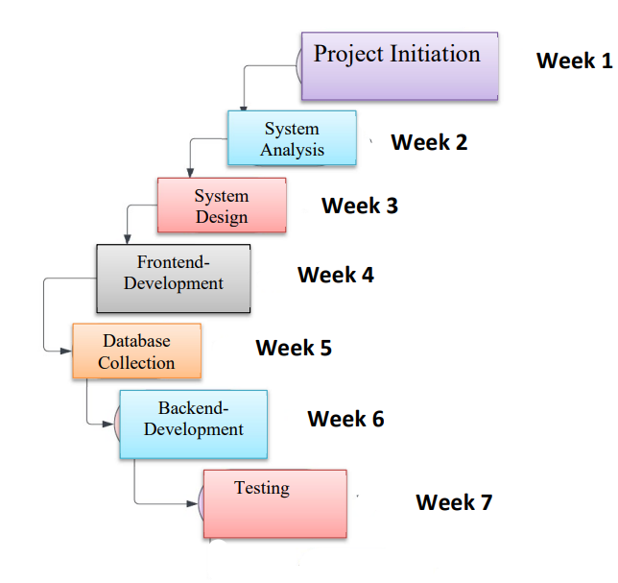
PROJECT TIMELINE

Slide 8


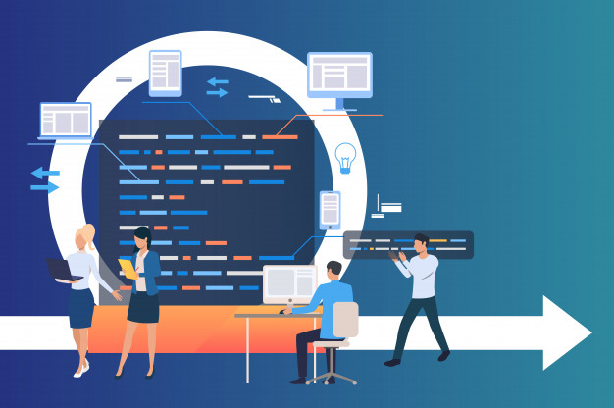
Software Requirements:
Frontend Development:
• HTML
• CSS
• React (JavaScript library for building user interfaces)
Backend Development:
• Python (Programming language for backend logic)
• MongoDB (database for storing and managing data)

Slide 9




Manual Tracking and Errors:
Manual inventory tracking leads to errors and inefficiencies.
Lack of real-time visibility into inventory levels.
Process Inefficiencies:
Problem Statement
Disparate systems and processes across warehouses cause inconsistencies in inventory records. Inefficient order fulfillment processes result in delays and customer dissatisfaction.
Replenishment Issues:
Inefficient stock replenishment processes lead to stockouts or excess inventory. Manual handling of stock replenishment results in delays and errors

Slide 10
Creating an effective inventory management system is crucial for businesses, but it comes with its set of challenges. Some current challenges in developing such systems include:
Integration Complexity: Integrating inventory management systems with existing software and hardware infrastructure can be challenging, especially in complex IT environments with multiple systems and data sources.
Data Accuracy and Quality: Ensuring the accuracy and quality of inventory data is a significant challenge, as errors or inconsistencies in data can lead to incorrect inventory levels, stockouts, or overstock situations.
Scalability: Building inventory management systems that can scale to accommodate growing business needs, increased transaction volumes, and expanding product lines requires careful planning and design.
Automation and Optimization: Developing automated workflows and optimization algorithms for inventory replenishment, order fulfillment, and demand forecasting requires advanced analytical and algorithmic capabilities.
User Adoption and Training: Educating users about the features and functionalities of the inventory management system and ensuring their buy-in and adoption can be challenging, especially if the system requires significant changes in workflow or processes.
Current Challenges

Slide 11


For Warehouse Management-
Oracle NetSuite Inventory Management System optimizes inventory control, automates processes, and enhances visibility, boosting supply chain efficiency and operational performance
LITERATURE REVIEW
The literature review begins by exploring the landscape of current inventory management systems
LetsTranzact-
It is a software solution primarily used for tracking and managing various types of inventory, including physical goods, supplies, and products, within a business context.

Slide 12


Healthie-a workflow responsible for keeping track of your health system's inventory, purchases, orders, payments, and more.
LITERATURE REVIEW
Access reports to instantly see your best sellers, total sales, and total taxes. Know exactly what products you have stocked with the Inventory Summary report.

Slide 13





Flowchart
LOGIN
Authenti-cation
Dashboard
Goods
Customer order
END
START
View and add goods
View Customer
View process
Update goods
Detail goods

Slide 14
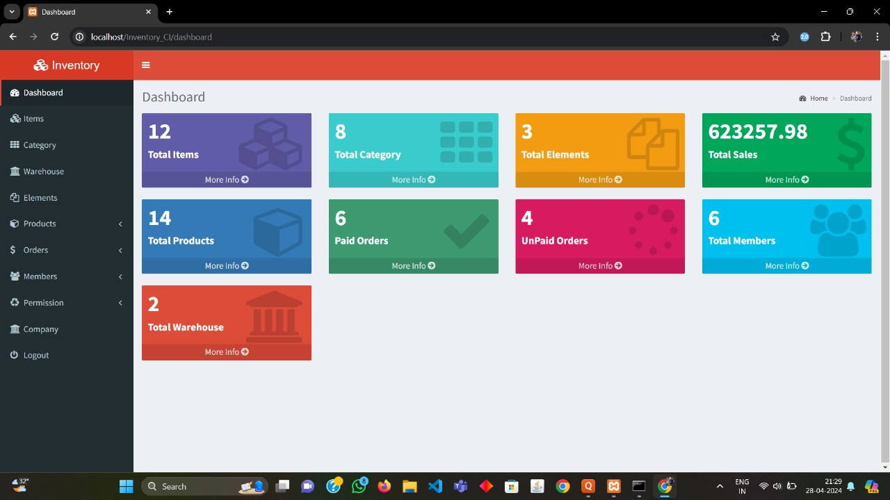
DASHBOARD

Slide 15
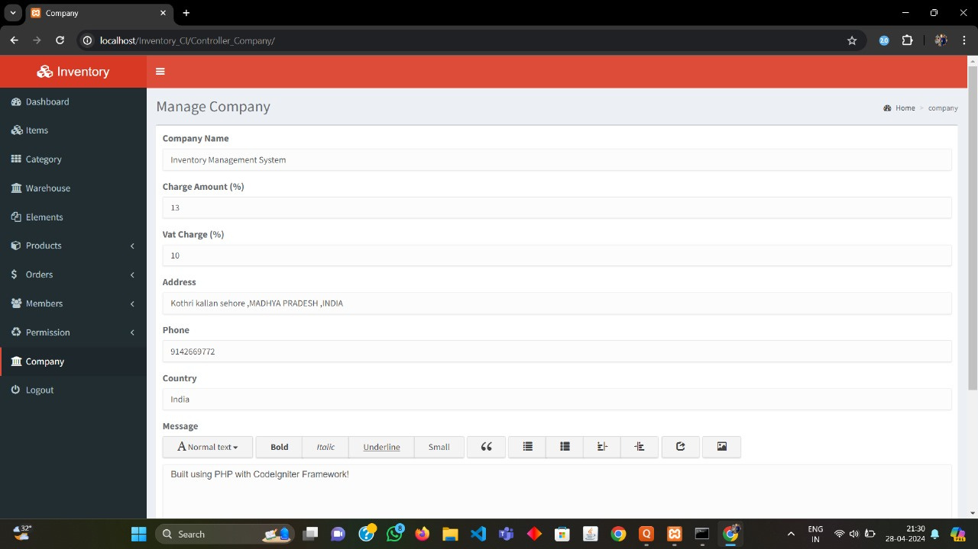
MANAGE COMPANY

Slide 16
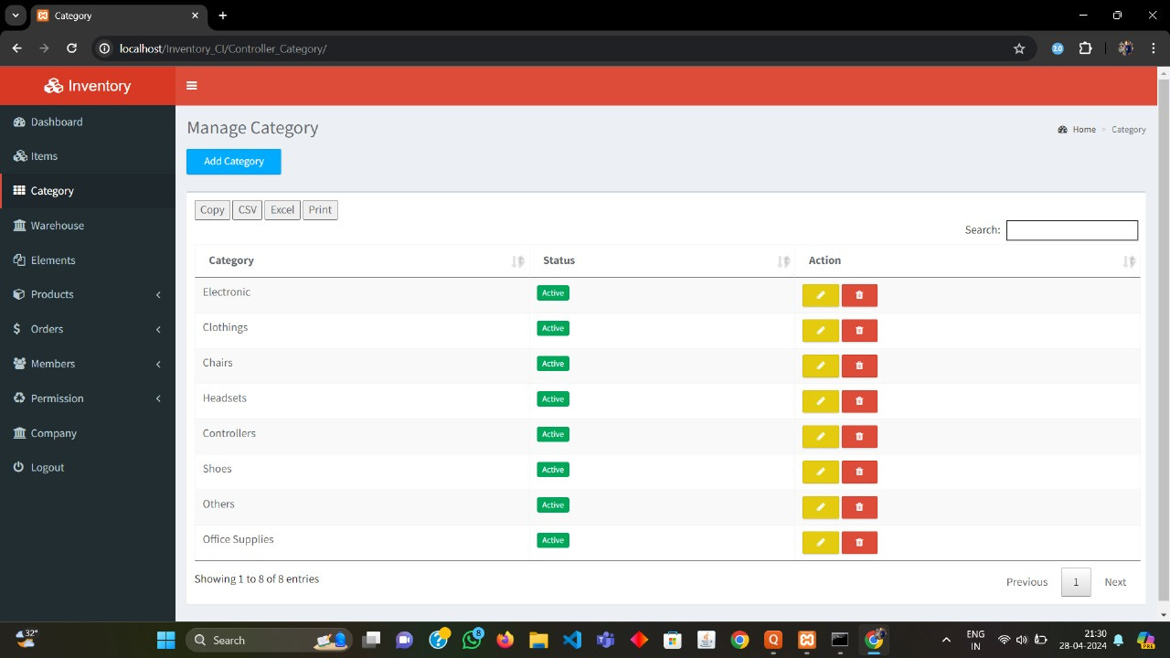
MANAGE CATEGORY

Slide 17
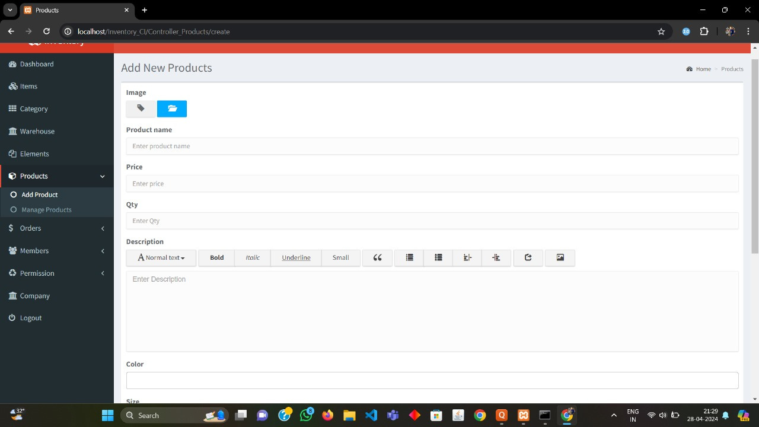
ADD PRODUCT

Slide 18
Uniqueness of the project
USER ACCESS PERMISSION-
Manage Access only those users can access the website who are given the access by the admin.
This means that different users, like administrators and employees, can only access certain features based on their roles. For instance, administrators may have access to all controls, while employees may only access specific functions related to their job responsibilities.
PRINT BILL-
The uniqueness of the print bill feature lies in its ability to generate detailed and accurate invoices for transactions, facilitating seamless record-keeping and product management.

Slide 19
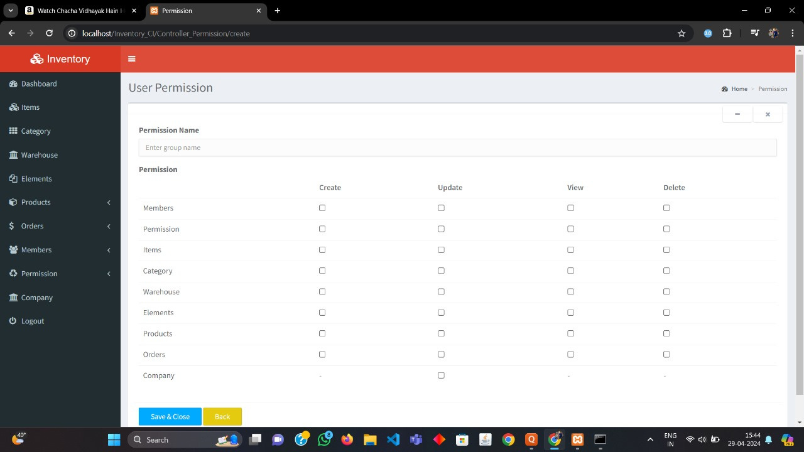
USER ACCESS

Slide 20
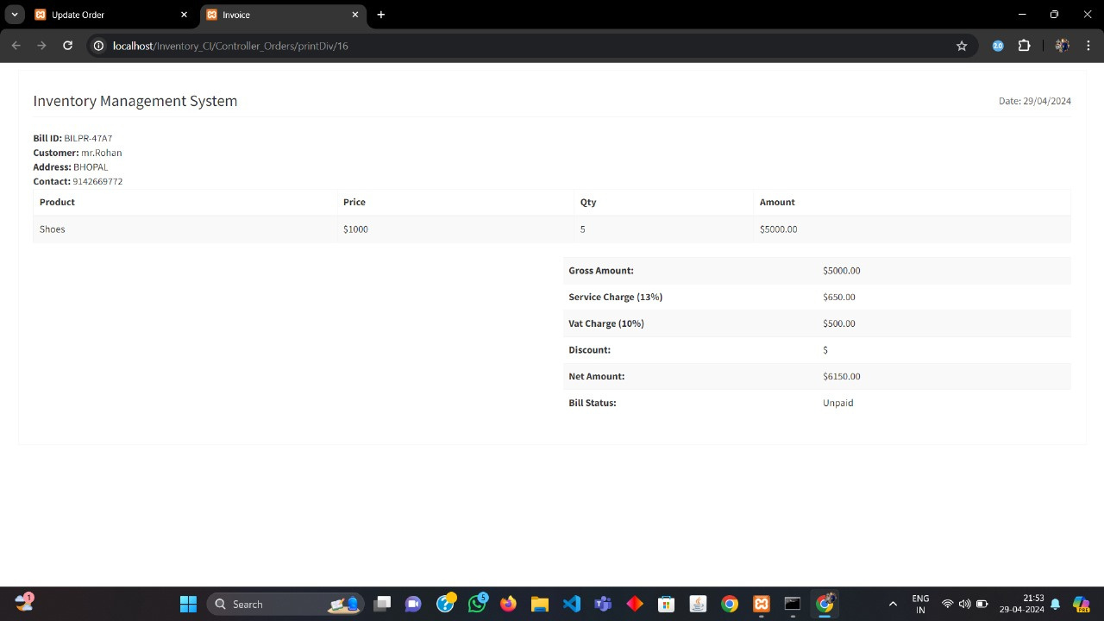
PRINT BILL

Slide 21

Mehodology
Requirement Analysis:
This involves identifying the needs of the users, such as tracking inventory levels, managing orders, and generating reports.
System Design:
This includes defining the database schema, user interface, and functionalities of the system. Consideration should be given to scalability, security, and usability.
Database Design:
By creating a database schema to store all relevant data related to inventory, products, orders, customers, and transactions. such as Design tables

Slide 22

Frontend Development:
This involves designing screens, forms, and menus to allow users to interact with the system effectively. Use technologies such as HTML, CSS, and JavaScript for frontend development.
Backend Development:
This includes handling business logic, data processing, authentication, authorization, and integration with external systems. Use programming languages such as MongoDB, C++, php
Deployment:
Deploy the inventory management system to a production environment. Configure servers, databases, and other resources necessary for the system to run smoothly.

Slide 23

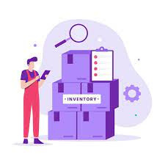
CONCLUSION
In conclusion, the implementation of an inventory management system offers significant benefits to our organization. By optimizing inventory levels, improving efficiency, and reducing costs, we can streamline operations and enhance customer satisfaction. The system's key features, such as real-time tracking, automated replenishment, and accurate forecasting, enable us to make informed decisions and respond promptly to market demands. Looking ahead, ongoing enhancements and optimizations will further strengthen our inventory management capabilities. We are confident that this system will continue to drive growth, improve profitability, and position us for success in an increasingly competitive landscape. Thank you for your support and commitment to this initiative.

Slide 24

THANK YOU

